Slide 1
Ecommerce
Start selling online today. Build a business by using our fast, safe and secure online store option that integrates with our builder.

Slide 2
Agenda
1
2
3
4
Importance of ecommerce
Online Store
Features & Benefits Overview
Addressing Common Concerns

Slide 3

Ecommerce allows businesses to make sales outside of business hours
Online sales increased during covid due to ecommerce stores. Allowing businesses to sell outside of their business hours widens the type of customers they can serve.
Selling online benefits consumers and business owners; Consumers are no longer limited to local shops and businesses selling online have access to a whole new demographic.
As per Forbes
21%
of retail purchases are expected to take place online in 2023.

Slide 4
Cost of not having an online store
Lack of trust
Customers will purchase from businesses they can rely on. By making a store available 24/7 the business becomes more reliable and a brand customers trust.
Lack of insights
Businesses miss out on the opportunity to gather valuable data and insights about online customers, their preferences, and their buying behaviors.
Missed sales opportunities
If customers are looking to buy online and a business doesn’t have an online store, they will find a competitor that does. Businesses are also missing out on promoting products online and across social platforms
Lack of flexibility
Having an online store means sales do not depend on a physical store’s hours of operation. This means business owners can sell products when their shop is closed.

Slide 5
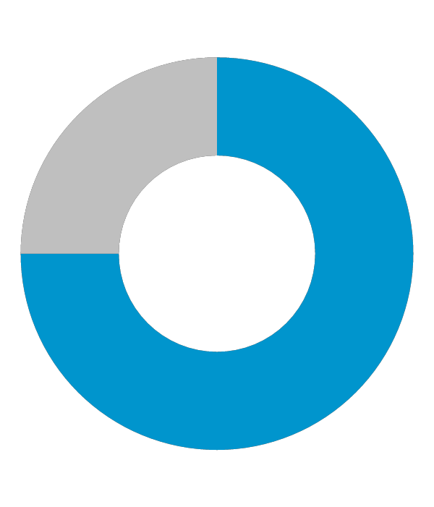
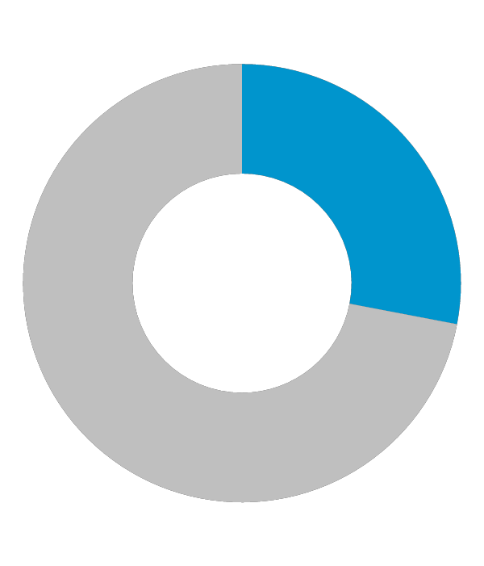
Impact of Ecommerce on businesses
79%
$6.3 trillion
57%
of online shoppers report shopping internationally
Forbes
of shoppers shop online at least once a month
Forbes
The global e-commerce market is expected to total $6.3 trillion in 2023
Forbes

Slide 6

Online Store
Simple
Professional
Accessible on any device
Ease of use
Safe and secure
Cost savings

Slide 7

One Seamless Experience
Full-featured e-commerce platform is integrated within Online Presence Builder – simply click a button to add it to the website.
Sell products directly on the website, blog and through Facebook.
Customize how the store will look to customers; edit layout, colors, fonts and more.
Mobile responsive storefront (desktop, tablet, mobile).

Slide 8
Features
Payments
Select the most suitable way to collect payments from customers, including check, cash and credit card payments. Integrates with top payment providers like PayPal, Authorize.net or First Data to make online purchases with the store fast and easy. Safe and secure payment processing. Quickbook compatible. Customer can create profile or checkout as a guest (configurable).
Tracking
Customizable order email notifications to multiple recipients. Mange product inventory. Order history for customers and administrator. Track payment and shipping status.
Management
Includes Dashboard, sales, ability to manage the store using the mobile app, catalog (manage products and categories), Customers, promotion (coupons and volume discounts) and system settings
Customized options
Geographic and local customization automatically sets currency, tax and calculates shipping rates. Sync company information. Set-up shipping methods and rates.

Slide 9
How it works

Slide 10
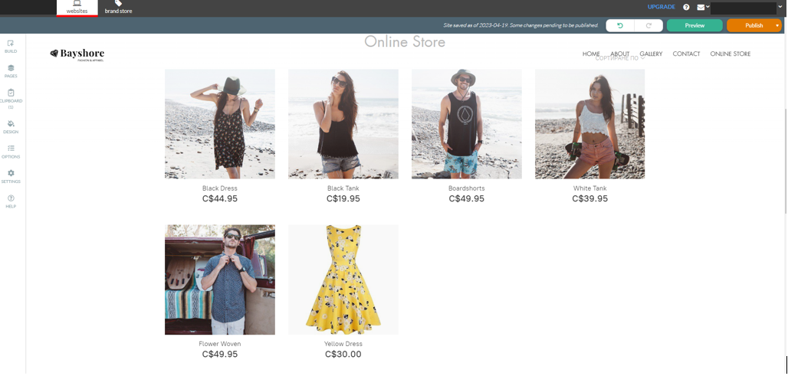
Activate the online store
Login to the portal and activate the online store, to launch the on-boarder
Add products you want to sell including a photo, description and price.
Customize the store for the location i.e. currency and metrics.
Set up shipping, choose a carrier, rates and other options like setting a flat rate or choosing a local carrier.
Set up a way to receive payments

Slide 11
Benefits
Creating a store is easy; no technical knowledge necessary. It is directly integrated with Online Presence builder
Simple
Cost effective
Online Store is an affordable and cost-effective solution, with a low monthly subscription rate and no transaction fees.
Create a great looking online store that uses modern themes, a free gallery of professional images, and simple options to add products, market services on different social media sites, create discounts and more.
Professional
Secure
All data is safe and secure; all credit card and transaction data is transmitted via secure HTTPS protocols and follows gold standards for secure e-commerce.

Slide 12
Q & A / Next steps

Slide 13
Frequently Asked Questions

Slide 14
1. What is Online Store?
Online Store is a powerful shopping cart/storefront that seamlessly integrates with your existing website. It’s an add-on feature within the easy-to-use cloud-based Online Presence Builder, which allows anyone to build impressive websites that perform on every screen, and helps you get found online.
With Online Store, anyone can add products for sale, set tax and shipping rates, and receive automatic notices when orders are received online.
2. How can I accept payments?
Online Store provides various payment methods, starting from accepting credit cards via PayPal to manual order processing. With Sell 100 or above, you will be able to connect your store to major payment processors such as PayPal, Authorize.Net, Stripe, 2checkout and many more.
Online Store doesn't store or transfer the money to you; rather it serves as a go-between in processing payments. Online Store keeps your customers' and orders data and provides you with tools to arrange payment and manage the orders.
‘Payment Methods’ in Online Store is where you set up a way to receive payments. Generally, every online store can support two types of payment methods: online and offline.
3. Can drop-shippers use Online Store?
Yes! We have many customers who use drop shipping services. In fact, Doba, one of the largest US based drop-shipping fulfillment companies recommends their customers to Online Store. Also, merchants can enter their fulfillment service’s email address in System Settings > Mail to receive order notifications automatically. Bonus!
4. How do I ship my items?
Online Store offers you a flexible mechanism to calculate and charge delivery rates. Choose a local carrier or set flat local, national, and worldwide shipping rates.

Slide 15
Probing Questions

Slide 16
Are you currently selling products on your website with an Online Store?
•No.
With more people going online first to search for products and services, you want to be in a position to convert these shoppers into buyers by offering them the ability to purchase online.
Getting started to sell online is simple. Setup your store in minutes. An easy to use on-boarder walks you through adding the product and details and setting basic tax and shipping rates.
•Yes. That’s great.
Is it easy to manage?
Do you have to use a different tool to manage your storefront versus your website?
Do you have proper reporting to manage your product inventory, order history and track payment and shipping status?
Are you paying transaction fees with your current solution?
Do you have a Facebook page?
•Yes? Great, Online Store can be integrated right into your Facebook page, as a new tab. It’s quick and easy and you can be selling through your Facebook page today.
•No? Facebook business pages are free, and in just a few minutes you can be selling your products through the most popular social network with Online Presence Builder.
Have you thought about selling gift certificates?
You don’t have to sell products to sell online. As a business that sell services, you can offer your customers the ability to purchase gift certificates that they can use towards a future purchase. Consider using gift certificates to sell products during high-opportunity occasions, such as Valentine’s Day, birthdays, Halloween or the holidays.

Slide 17
Objection Handlers

Slide 18
Selling online is difficult, and I don’t have time to manage it.
The good news is that it has never been easier to start selling online. Anyone can do it and it only takes a few minutes of time to get started.
There’s a quick step-by-step on-boarder that walks you through how to start adding products, how to setup your currency settings and shipping options. Lastly the on-boarder will help you setup your payment options and Payment Processor.
The store will automatically send you an email when an order is placed, and keep you notified when your stock is running low. Online Store does all of the heavy lifting, so you don’t have to.
I already have a website and I don’t want to rebuild it on your system.
Online Presence Builder makes it easy to manage your website and store in one place; and if you have an existing website built on our platform then you can easily add Online Store in a few clicks.
Unlike other ecommerce companies our Online Store offers a great deal of flexibility allowing you to completely integrate with your current Online Presence Builder website.
That means you will not have to rebuild anything!
I’d rather invest in social.
With Online Store you can sell your products directly on your Facebook page! This gives your customers a convenient way to buy your products while syncing directly to your central inventory. You can add Online Store to multiple websites, blogs or social media pages, all while managing it in one spot. This makes managing your online presence incredibly simple and strengthens your brand across sites.

Slide 19
Test your Knowledge

Slide 20
1. What percentage of shoppers buy internationally ?
A) 33%
B) 72%
C) 57%
D) 64%
2.What is Online store?
A) A shopping cart that takes customers to another site to complete the sale
B) A powerful shopping cart/storefront that seamlessly integrates with Online presence builder.
C) A shopping cart that doesn’t manage your inventory
D) None of the above
3. True or False: The online store integrates with online presence builder.
A) True
B) False
4. What are benefits of using online store?
A) Simple
B) Cost effective
C) Secure
D) All of the above
5. What can you track with online store?
A) Inventory
B) Order history
C) Both A and B
D) None of the above
6. What percentage of customers shop online at least once a week?
A) 50%
B) 30%
C) 22%
D) 65%
7. True or False: Selling online is difficult.
A) True
B) False
8.Where can you sell using online store?
A) Website
B) Blog
C) Facebook
D) All of the above
9. Which are key features of Online Store?
A) Payments
B) Tracking
C) Customized options
D) All of the above
10. Which statement is false?
A) Ecommerce sales decreased during covid
B) Having an online store allows business owners to sell outside of store hours
C) Ecommerce sales increased during covid
D) Seamless integration with online presence builder makes adding an online store easy

Slide 21
Correct Answers
C) 57%
B) A powerful shopping cart/storefront that seamlessly integrates with Online presence builder.
A) True
D) All of the above
C) Both A and B
C) 22%
B) False
D) All of the above
D) All of the above
A) Ecommerce sales decreased during covid

